Slide 1

Irradiance estimation from sky images for PV power prediction
Amrollah Seifoddini Supervisor: Jan Poland
March 2016

Slide 2
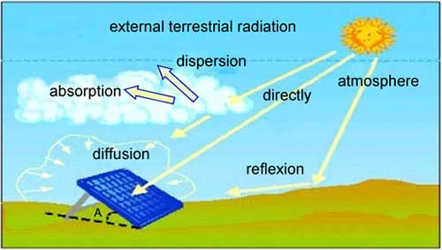
Motivation & goal
Sky imager based shortest-term solar irradiance forecasts for local solar energy applications

Slide 3
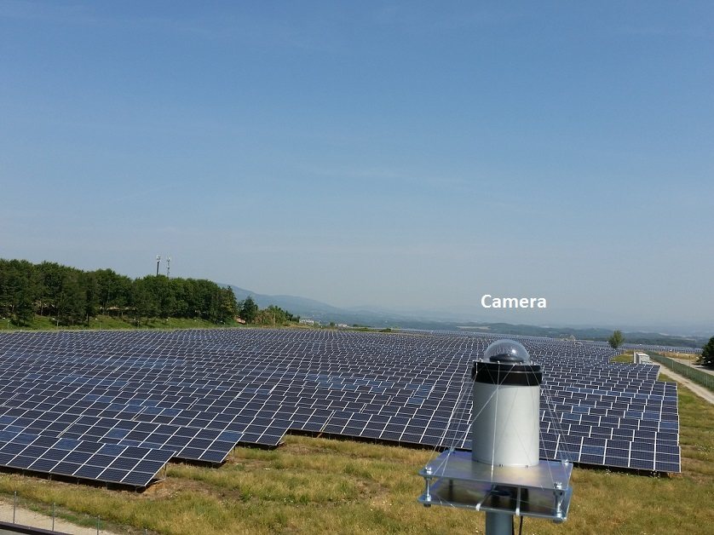
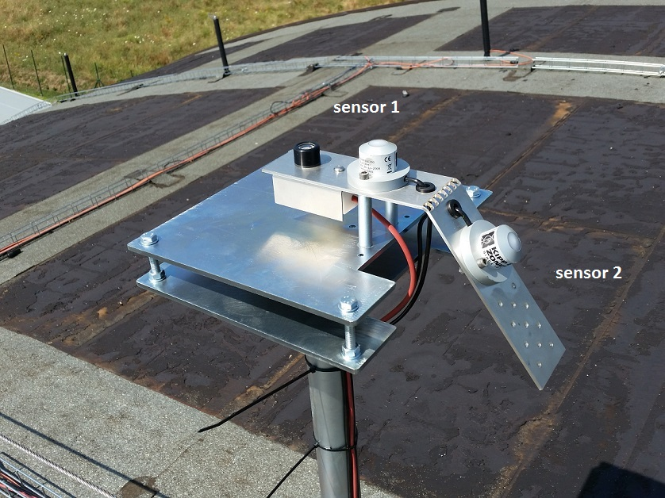
Experimental setup (in Cavriglia)

Slide 4
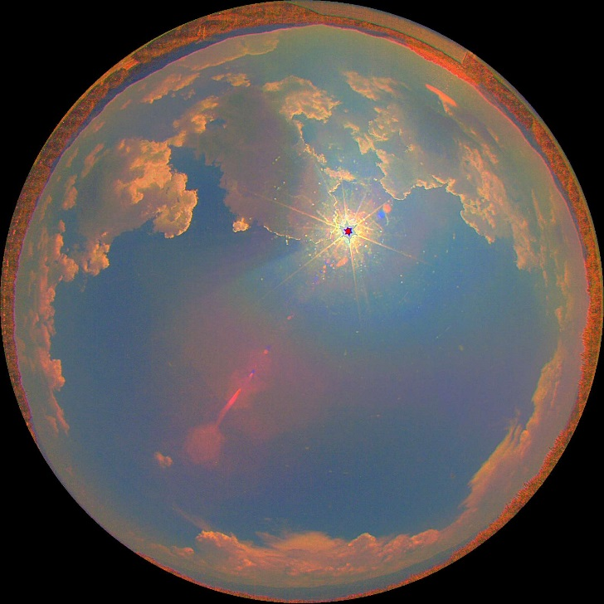
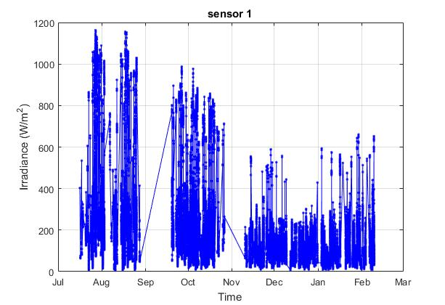
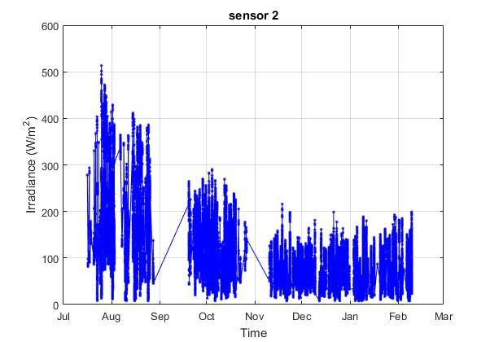
Acquired Data
HDR Images every 8 seconds
Irradiance and power every 6 seconds

Slide 5
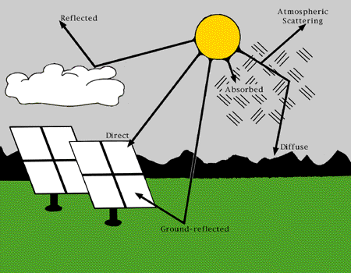
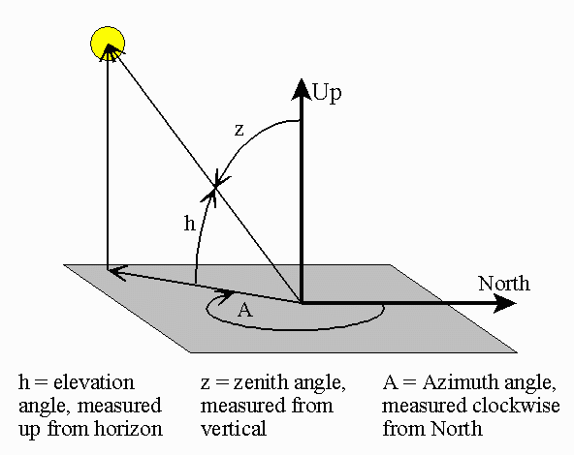
Irradiation components
Global Horizontal Irradiance (GHI)
Diffuse Horizontal Irradiance (DHI)
Direct Normal Irradiance (DNI)

Slide 6
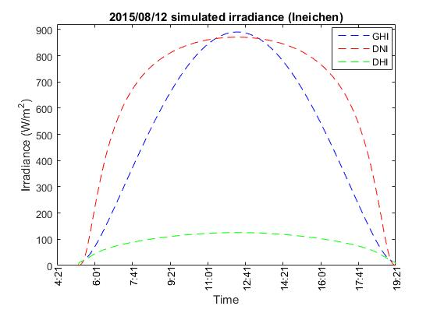
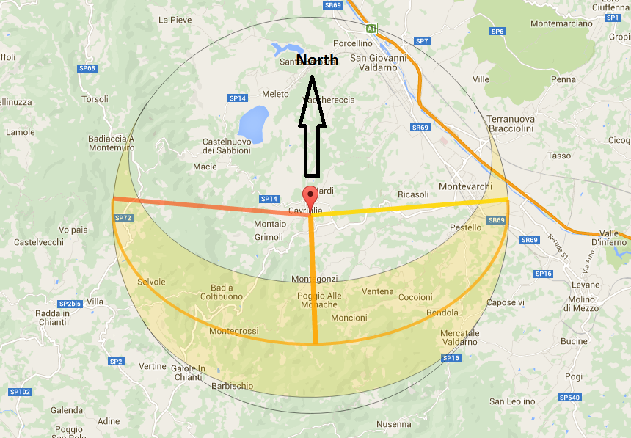
Irradiation components (cont.)

Slide 7
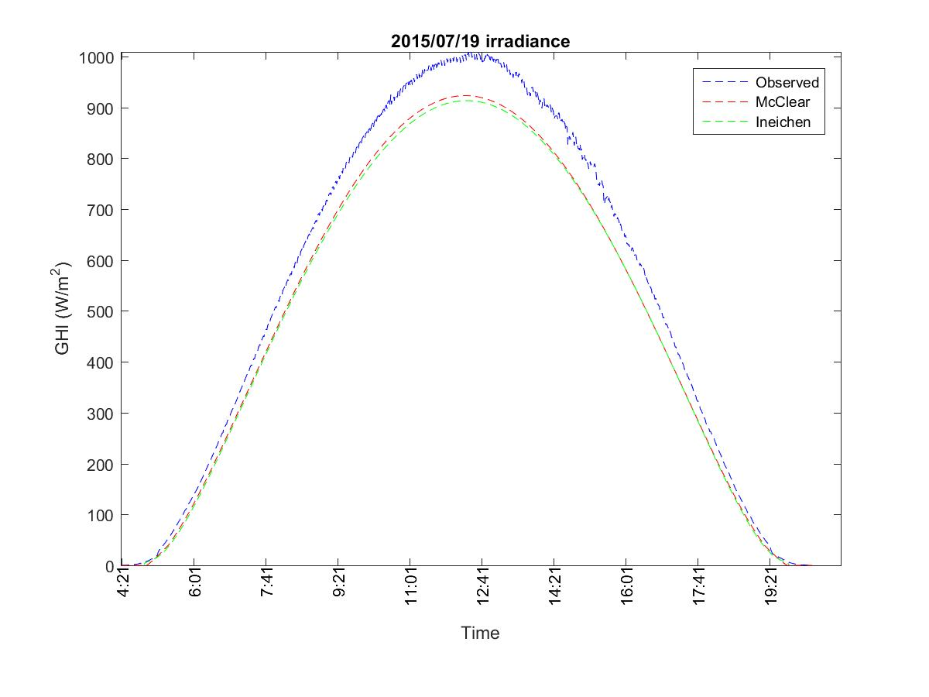
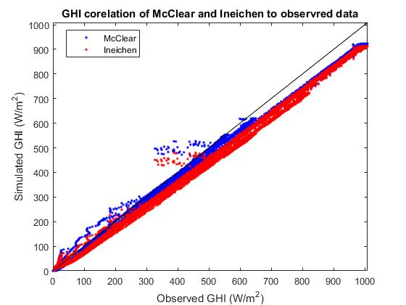
Clear-sky irradiance model

Slide 8
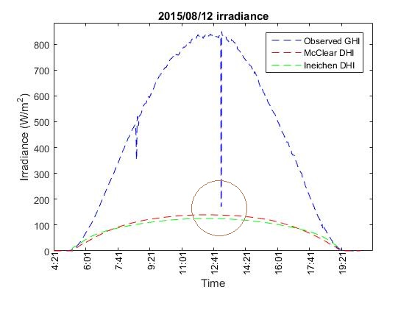
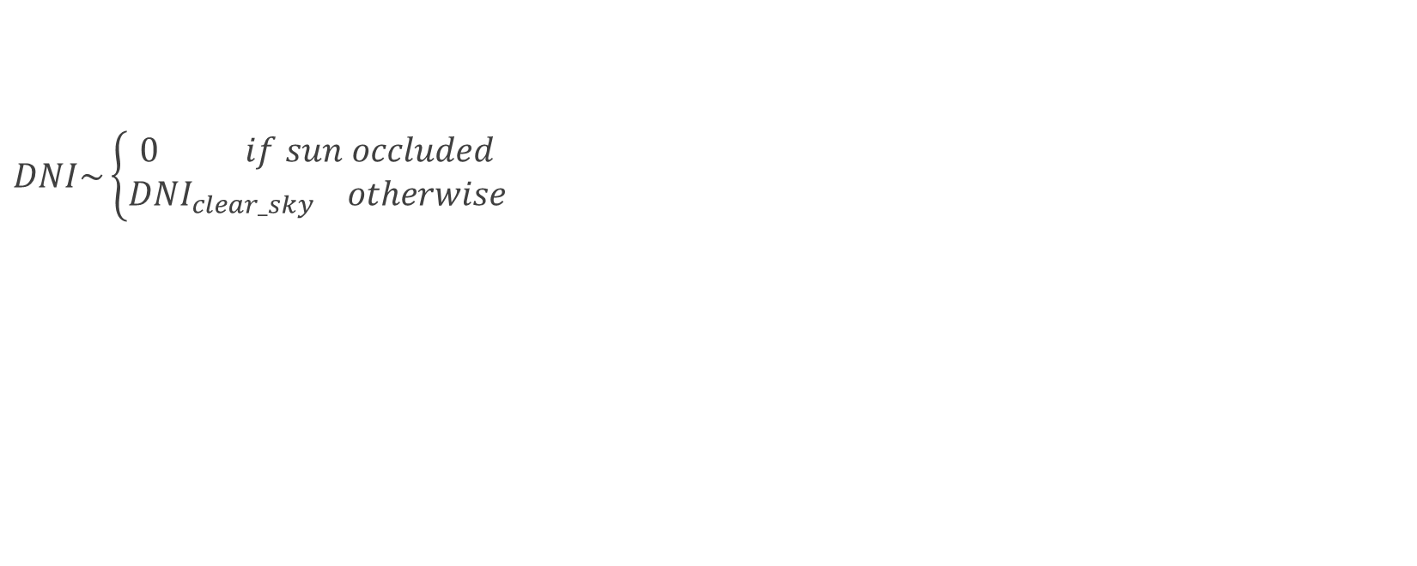
Estimating DNI (from clear-sky model)
$DNI\sim \left\{\begin{aligned}0 if sun occluded \\ {DNI}_{clear_sky} otherwise\end{aligned}\right.$

Slide 9
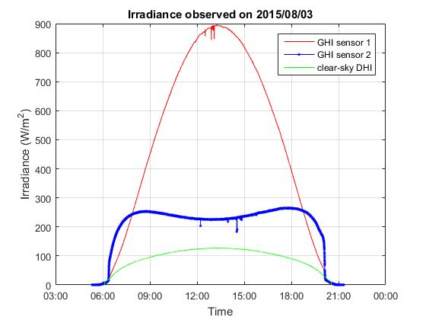
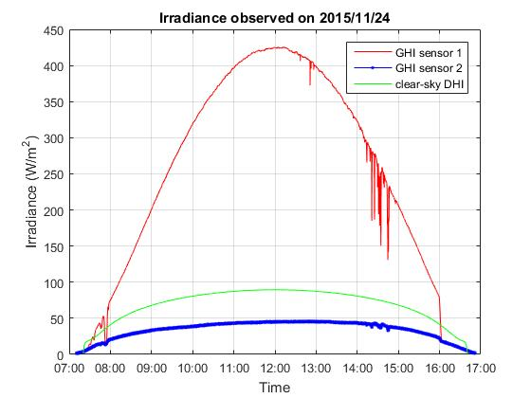
Estimating diffuse from sensors
Notes:
Using clear_sun_flag and estimated DNI for calculating diffuse from tilted plate
We only consider images with complete visible sun or no sun at all.
Extracted diffuse from north-facing plate is more robust than south-facing one

Slide 10
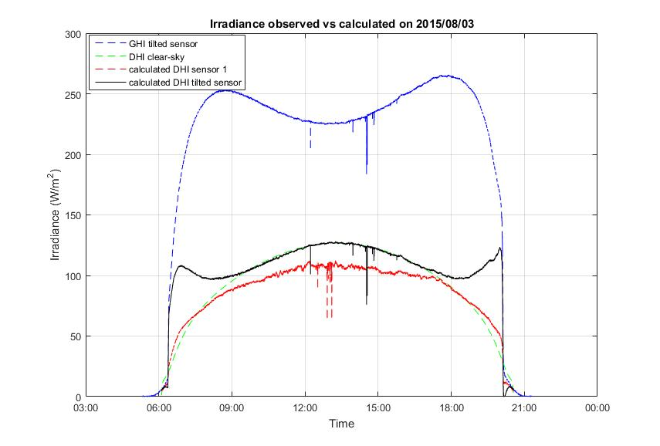
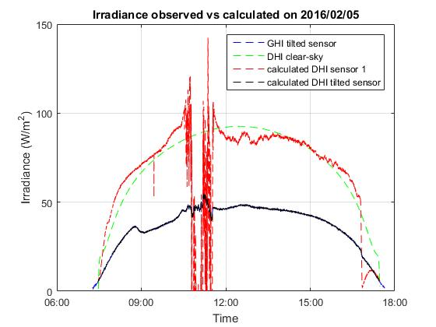
Estimating diffuse from sensors (cont.)
Notes:
Using clear_sun_flag and estimated DNI for calculating diffuse from tilted plate
We only consider images with complete visible sun or no sun at all.
Extracted diffuse from north-facing plate is more robust than south-facing one

Slide 11
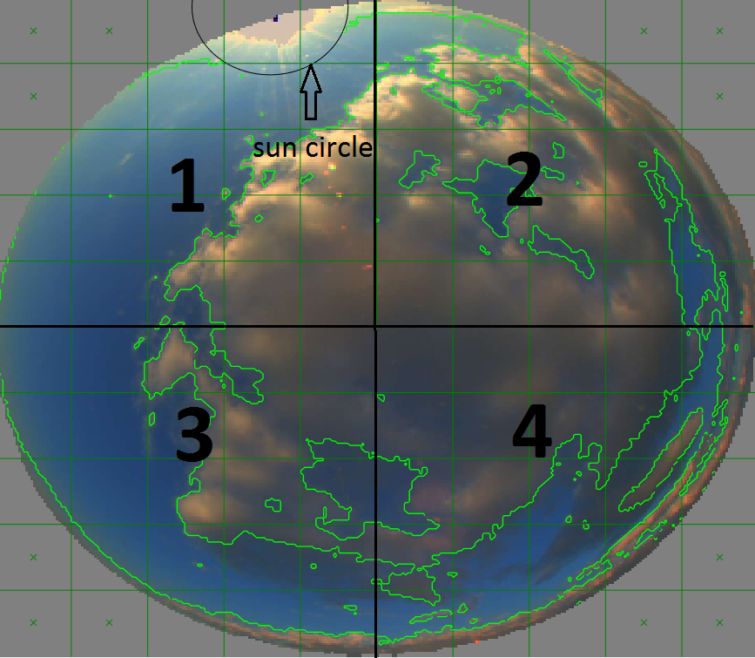
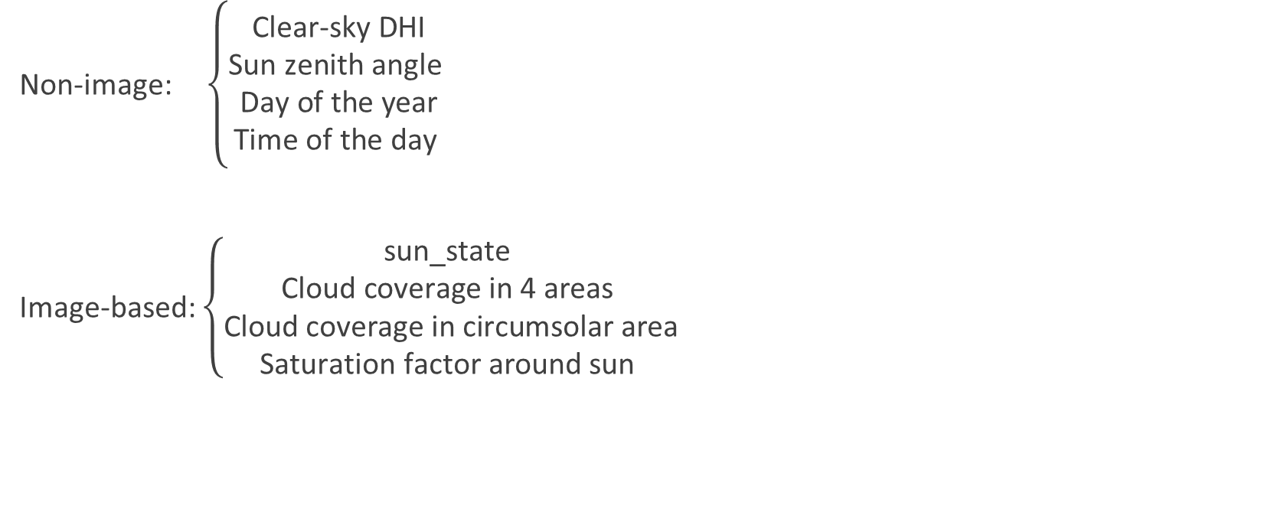
Estimating diffuse from Image features
Non-image: $\left\{\begin{aligned}\text{Clear}\text{-}\text{sky} \text{DHI} \\ \text{Sun} \text{zenith} \text{angle} \\ \text{Day} \text{of} \text{the} \text{year} \\ \text{Time} \text{of} \text{the} \text{day} \end{aligned}\right.$
Image-based: $\left\{\begin{aligned}\text{sun}\text{_}\text{state} \\ \text{Cloud} \text{coverage} \text{in}\text{ 4 }\text{areas} \\ \text{Cloud} \text{coverage} \text{in} \text{circumsolar} \text{area} \\ \text{Saturation} \text{factor} \text{around} \text{sun} \end{aligned}\right.$

Slide 12
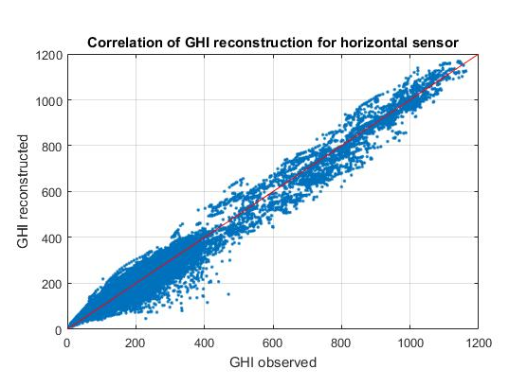
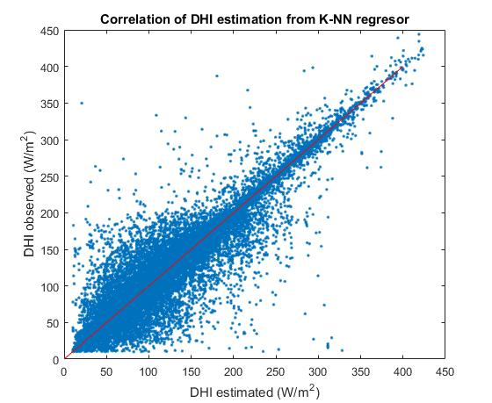
Regression result
RMSE = 26

Slide 13
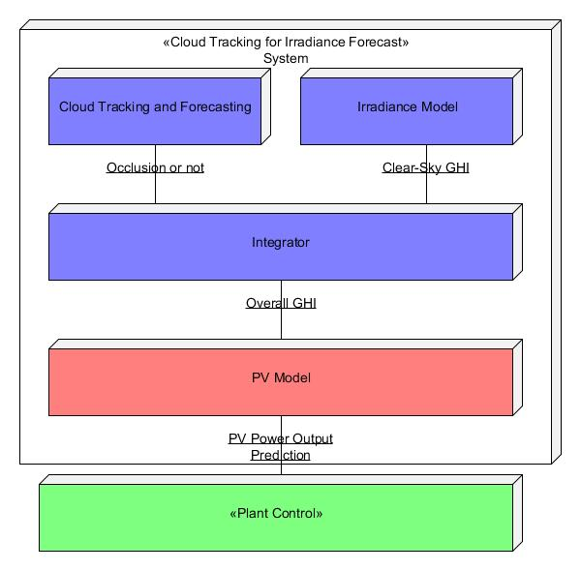
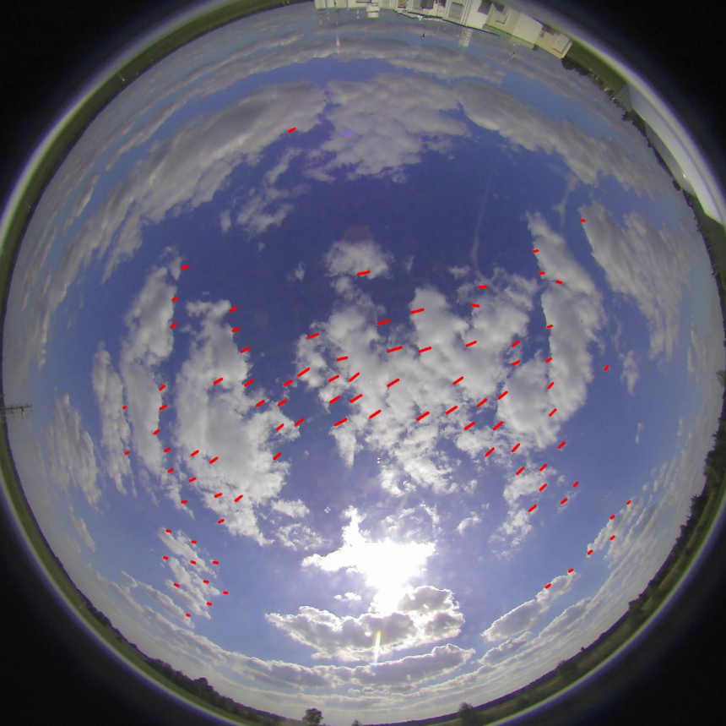
Application in irradiance forecast
Notes:
Using optical flow to extract clouds’ motion vector
Move the clouds with same motion vector

Slide 14
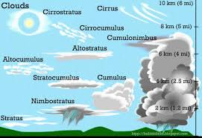
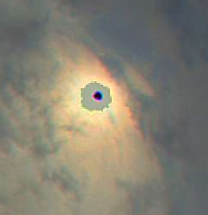
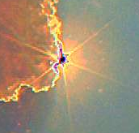
Future work
Consider partial sun occlusion
Cloud type classification

